Slide 1
Data Science for Impact and Decision Enablement (DSIDE)
Phase 2: Machine Learning
<Rugby Event Detection>
By
<Bongani Nondyiwane, Kelebogile Letshwene and Singita Ngobeni>
Contents
31 January 2018

Slide 2
Contents
Project Objectives
Description of Dataset
Gather and Prepare
Explore and Assert
Validate
Communicate
Final Project Outcome

Slide 3

Project Objective
Developing an AI based learning system that can identify events (scrums, lineouts, kicks, etc. ) in near real-time
Notes:
MAX 1 slide

Slide 4
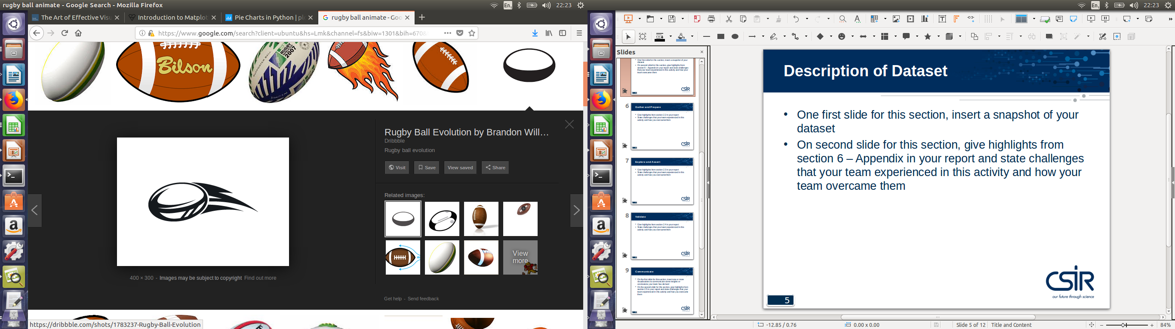
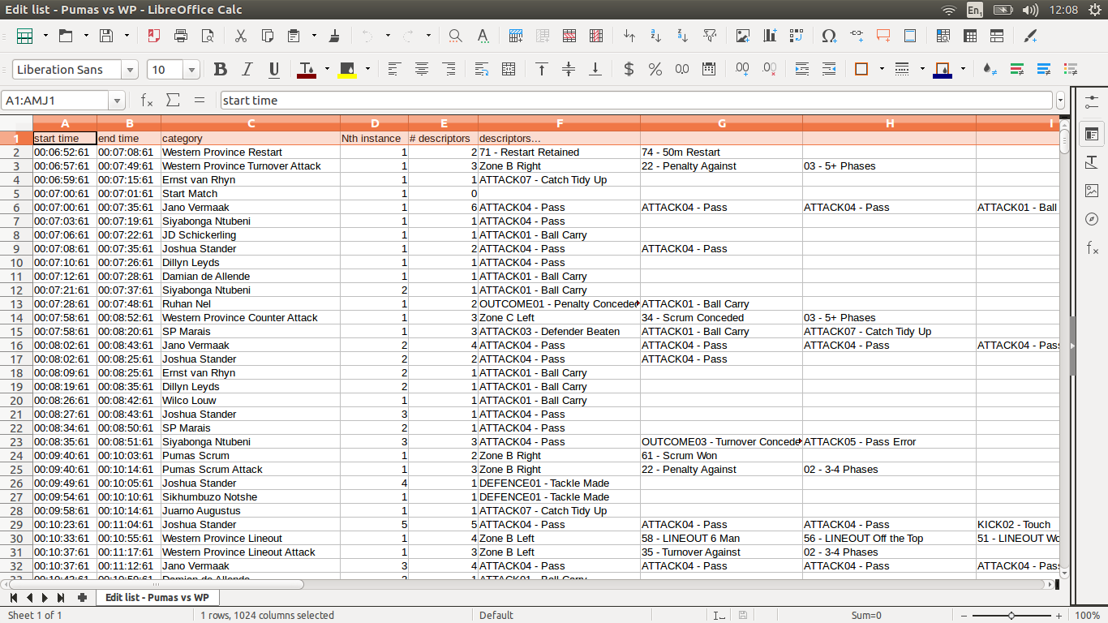

Description of Dataset
Three rugby matches each with over 500 events some with timestamps labeled and classified per team and per player were provided
Notes:
MAX 2 slides

Slide 5
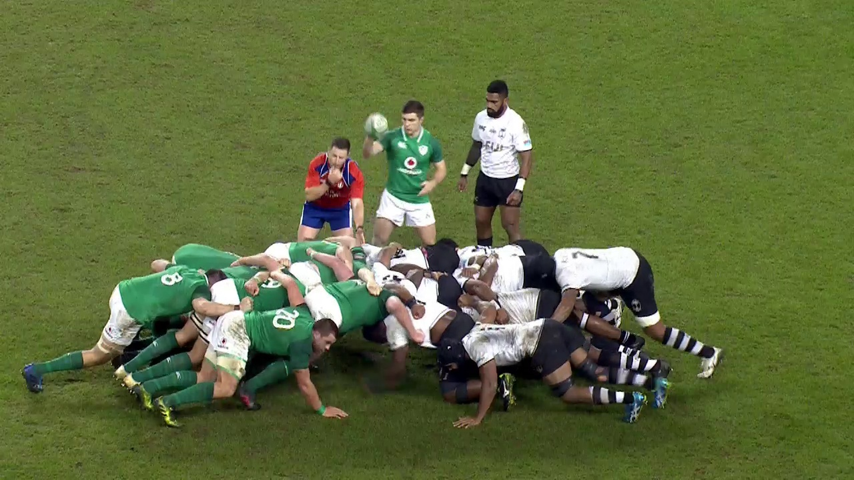
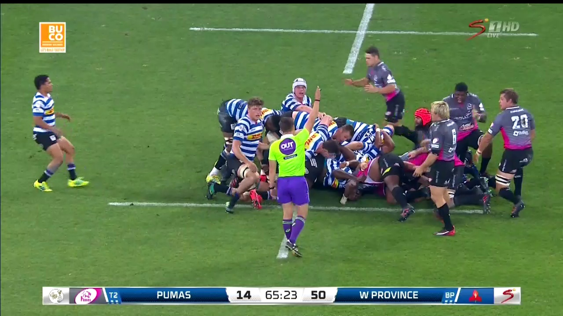
Description of Dataset...
The data consisted of video data and labeled events in a “code” file

Slide 6
Description of Dataset...
Data provided from the videos was in complex spreadsheets which had timestamps and associated events within each time period window
Data cleaning and reshaping skills were employed to get data cleaned and usable for analysis
Notes:
MAX 2 slides

Slide 7
Using the given dataset consisting of timestamps of different events occurring
The collection of clips were split by their action class and collected for the entire match
Moviepy was used to to extract the clips from the video stream
Gather and Prepare
      Data Preprocessing & Handling
Notes:
MAX 1 slide

Slide 8
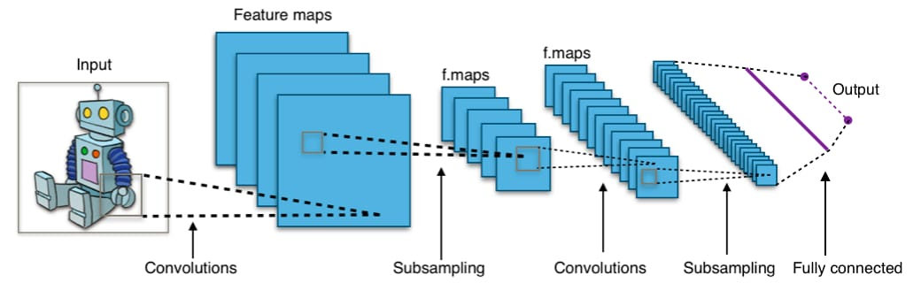
Explore and Assert
The type of model we used is called Sequential modelling
Sequential is the easiest way to build a model in Keras
It allows you to build a model layer by layer
      Convolutional Neural Network Model
      Source:
      http://stackoverflow.com/questions/49620798/fusing-two-different-cnn-models-in-tensorflow

Slide 9
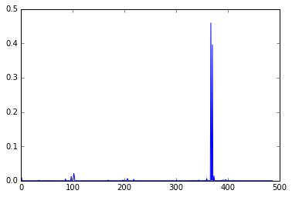
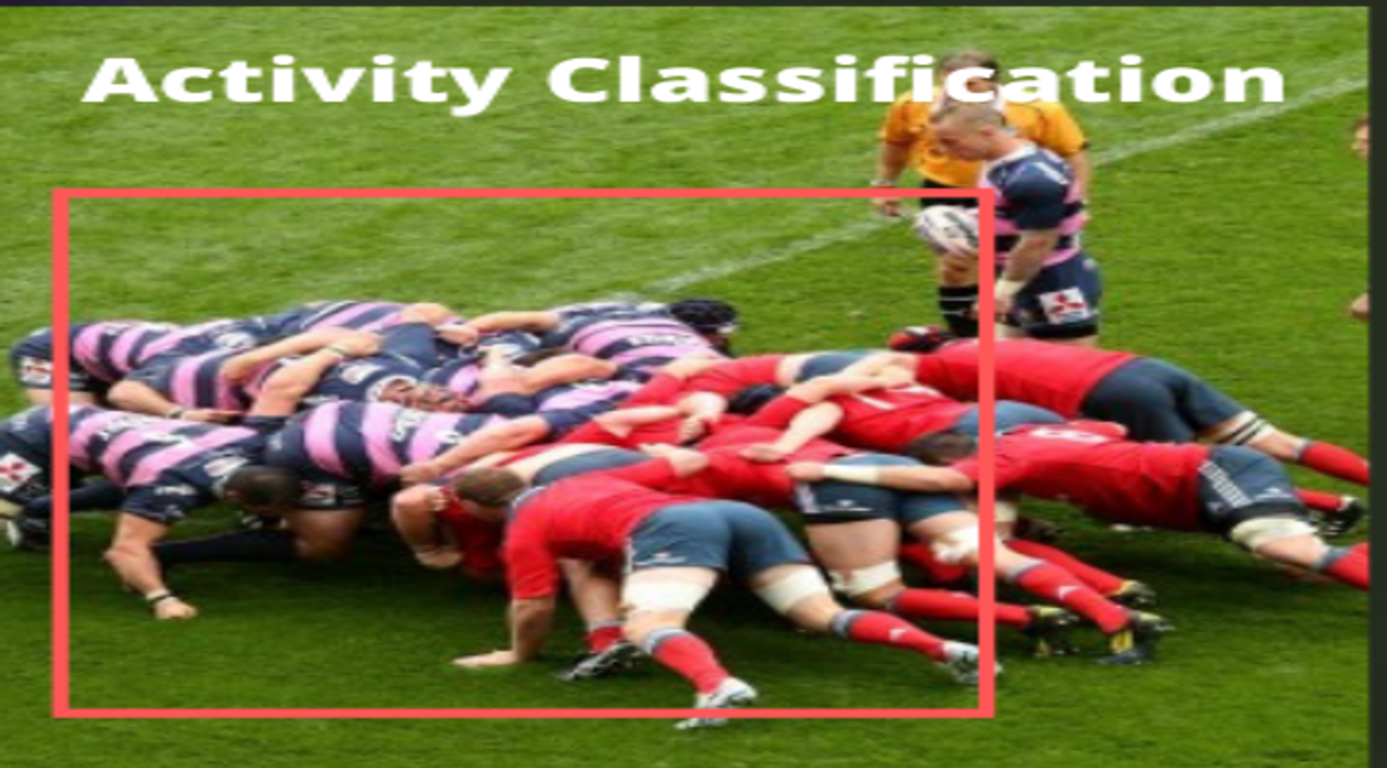
Explore and Assert...
      Data Classification
For further testing, a video was loaded and made to pass through the model
Thereafter the probability of each action class being classified was plotted (where the class with the highest probability was used to identify the object as being correct)

Slide 10
Explore and Assert
We have a model that runs labeled video clips
We checked for the accuracy, test score and validation loss based on the ability of the model
We represented the data in graphical format where we used a plot to visualise
      Data Visualisation

Slide 11
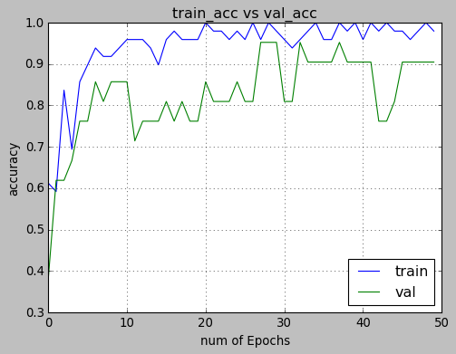
Explore and Assert.

Slide 12
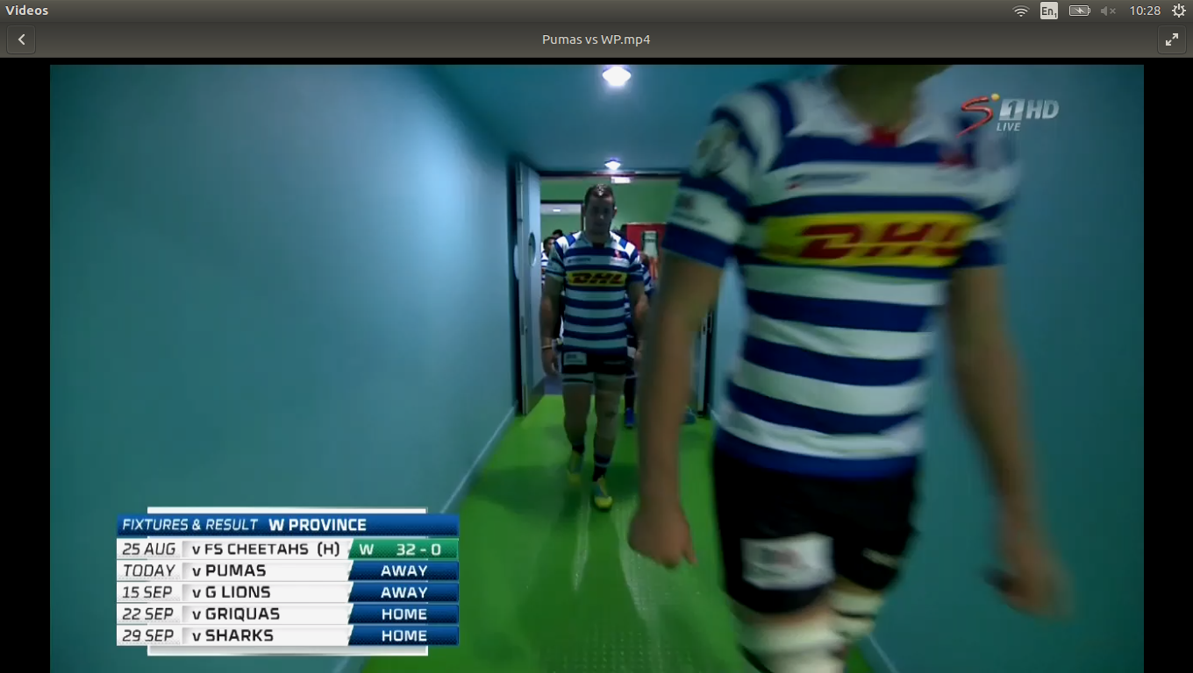
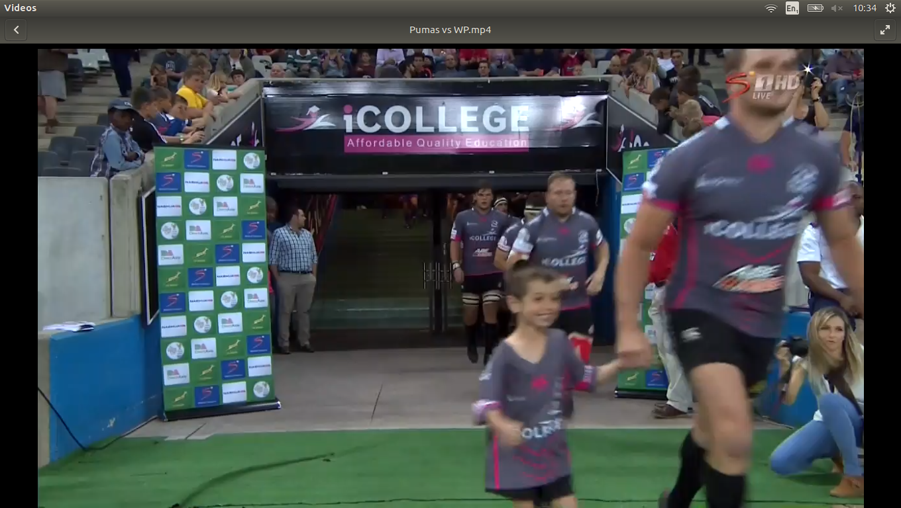
Validate
      Mentor Discussions
This task involved confirming with the mentor which events to focus on to give maximum training data
      Mentor Suggestion Points
Including more data points from the clips that are not classified.

Slide 13
Validate...
      Challenge
Using the libraries and packages that we needed for implementing our project.
      Solution
On-line sources such as text-based and video tutorials

Slide 14
Communicate
      Data Visualisation
Plots, Heat maps and Bar graphs were used.

Slide 15
Final Project Outome
  Tasks completed as Part of the objectives for the Project
Developed a deep learning engine to automatically classify events
Used the current dataset as a training set
Utilised deep learning (e.g CNN) to develop an automatic classification engine
Tested accuracy of classification

Slide 16
Final Project Outome...
  Project challenges
Limited time to work on project made creating effective final outcome difficult and data
  Solution
Provide an easy and useful tool which will enable analysis of real-time events in a rugby match
  Tools used
Jupyter notebook OpenCV
Matplotlib Moviepy
Keras

Slide 17
Thank you

